Slide 1
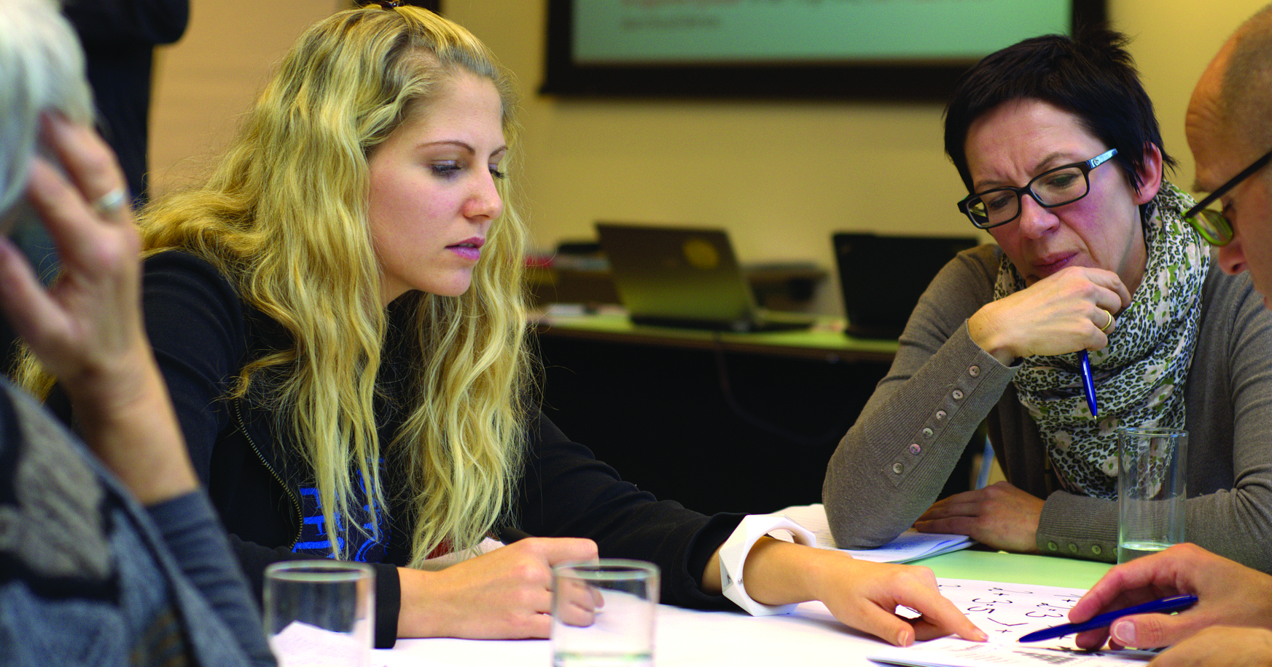
The Best Programming Languages
ricky brown, Hamid nahli, jesse law, Mimi Southwood, Nichelle garvey
It 115, group 2
SPRING 2022

Slide 2
Team and Project Management

Slide 3
JESSE - How did you change Code Compare?
GitHub -> Code Compare
READ.ME
CONTRIBUTING.md
License
index.html
styles.css
Powerpoint presentation
Secondary Survey repo

Slide 4
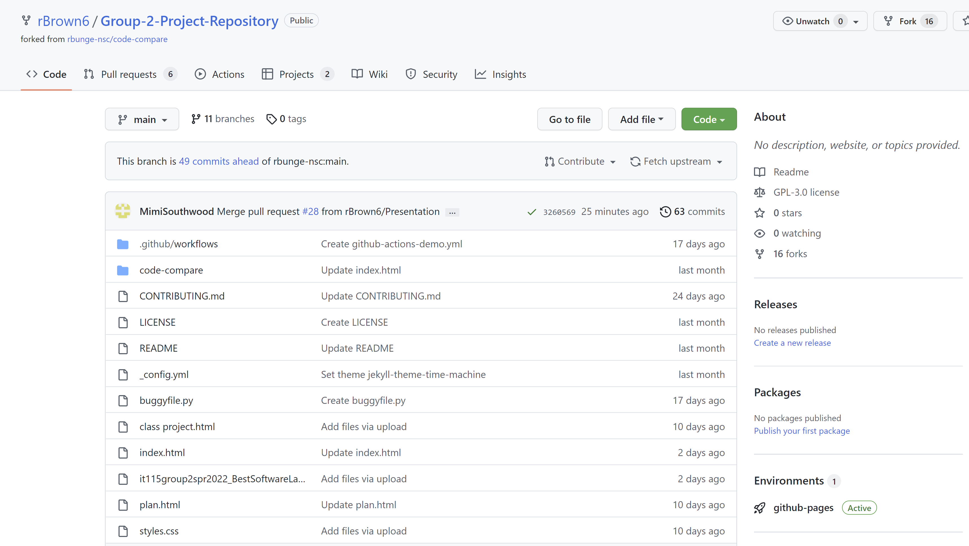
MIMI – Team Collaboration, Project Management, Roles, Project Page
Collaboration
GitHub – files, updates
Email - communication
Project management – plan.html
Roles – Division of Group Project deliverables – plan.html
Content
Project page - index.html
Survey – separate repo

Slide 5
MIMI – Project Page, Content
Team Contributions
Mission
Programming language recommendations
Survey results

Slide 6
NICOLE – Testing, Bug Tracking, and Updating and Fixing Code
4. Bug reports project board

Slide 7
NICOLE – Bug reports project board

Slide 8
RICKY – Web Server Hosting, Process for Configuring Web Server

Slide 9
RICKY – Super-linter workflow

Slide 10
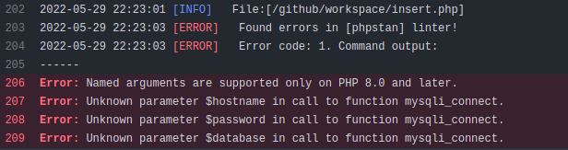
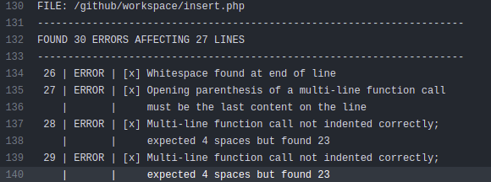
Super-Linter Workflow
Super-Linter showed its usefulness when it came to creating the survey part of our project, particularly within building the back-end elements. The application worked by tying an HTML front end framework together with a MySQL database server that existed on our AWS EC2 instance, using PHP as the business layer. With none within our group having any experience using PHP, an automated testing tool like Super-Linter was helpful. Though It certainly cannot serve as a stand-in for lack of programming knowledge.

Slide 11
HAMID – Deploying Code to the Server, URL for Testing

Slide 12
HAMID / RICKY – Summary of Project Pages, Assets

Slide 13
Team Recommendations
HTML – Ricky Brown
CSS – Nicole Garvey
JavaScript – Jesse Law
SQL – Mimi Southwood
Python – Hamid Nahli

Slide 14
Our Survey
RESULTS?

Slide 15
Thank you!

